Slide 1
SUBMITTED BY
GOPINATH DAYALAN
DINESH KUMAR
HARI
B.TECH (IT)
UNDER THE GUIDANCE OF
Ms.A.PUNITHA, ME
ASSISTANT PROFESSOR(OG)
AFFECTIVE TEXT BASED EMOTION
MINING IN SOCIAL MEDIA

Slide 2
OBJECTIVE
The main aim of our project is to find the connections between emotions and affective terms by categorizing the web-content, based on the emotion present in it and also predicting the emotions from text automatically.
AFFECTIVE TEXT BASED EMOTION MINING IN SOCIAL MEDIA
1 of 23

Slide 3
EXISTING SYSTEM
Different methods used to deal with the affective text mining process are,
  Emotion-Term model
  Topic based-SVM model
DISADVANTAGES
  Cannot discover the contextual information within the document
  Cannot bridge the connection between social emotions and affective text
AFFECTIVE TEXT BASED EMOTION MINING IN SOCIAL MEDIA
2 of 23

Slide 4
PROPOSED SYSTEM
Joint Emotion topic model for social affective text mining which introduces an additional layer of emotion modeling into Latent Dirichlet Association
ADVANTAGES
  To increase the efficiency of the process
  Accurately model the connections between words and emotions
AFFECTIVE TEXT BASED EMOTION MINING IN SOCIAL MEDIA
3 of 23

Slide 5
ARCHITECTURE DIAGRAM
EMOTION #1
SERVER
EMOTION #2
INPUT
URL
EMOTION #3
.
.
.
.
COMPARE
EMOTION #8
VOCABULARY
AFFECTIVE TEXT BASED EMOTION MINING IN SOCIAL MEDIA
4 of 23

Slide 6
DATA FLOW DIAGRAM
USER
SERVER
CONTENT
Give url
extract
  OPTIMIZED CONTENT
comparing
VOCABULARY
predicting
EMOTIONS
AFFECTIVE TEXT BASED EMOTION MINING IN SOCIAL MEDIA
5 of 23

Slide 7
MODULES
  Latent Topics Generation
  Extraction Process
  Optimization Processes
  Emotion Prediction
AFFECTIVE TEXT BASED EMOTION MINING IN SOCIAL MEDIA
6 of 23

Slide 8
LATENT TOPICS GENERATION
  Generate latent topics for each emotion that are to be considered
  Each latent topic is categorized and stored to check with the extracted content
AFFECTIVE TEXT BASED EMOTION MINING IN SOCIAL MEDIA
7 of 23

Slide 9
EXTRACTION PROCESSES
  Extract the title and main body of each required article
  The access of the main body of articles provides the basis for modelling latent topics and helps alleviate the issue of data sparseness
AFFECTIVE TEXT BASED EMOTION MINING IN SOCIAL MEDIA
8 of 23

Slide 10
OPTIMIZATION PROCESS
Segment all the words for each article
Remove all the words that has no meaning related to the specified emotions and by thus optimizes the content
AFFECTIVE TEXT BASED EMOTION MINING IN SOCIAL MEDIA
9 of 23

Slide 11
EMOTION PREDICTION
Compare the extracted and optimized content with the already found latent topics that relating to each emotion
Based on the emotion frequency the content is categorized
AFFECTIVE TEXT BASED EMOTION MINING IN SOCIAL MEDIA
10 of 23

Slide 12
SYSTEM SPECIFICATION
  HARDWARE SPECIFICATION
    Processor : 1.6GHz or faster processor
    Hard Disk : 3 GB of available hard disk space
    RAM : 1 GB
    Monitor : VGA and High resolution monitor
  SOFTWARE SPECIFICATION
    Operating system : Windows XP (SP3)
    Programming language : Java -JDK 1.6
    Back End : Oracle 10g
    Server : Apache tomcat6.0
AFFECTIVE TEXT BASED EMOTION MINING IN SOCIAL MEDIA
11 of 23

Slide 13
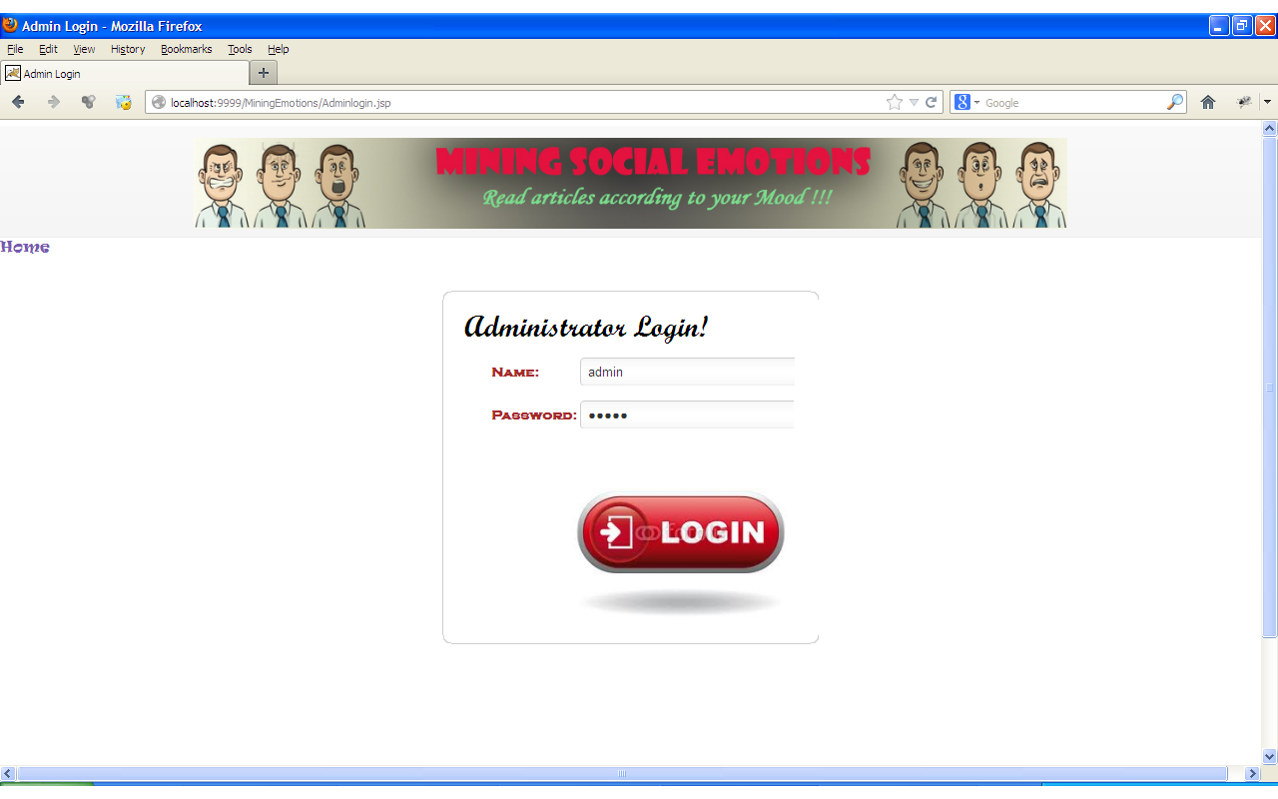
ADMINISTRATOR LOGIN
AFFECTIVE TEXT BASED EMOTION MINING IN SOCIAL MEDIA
12 of 23

Slide 14
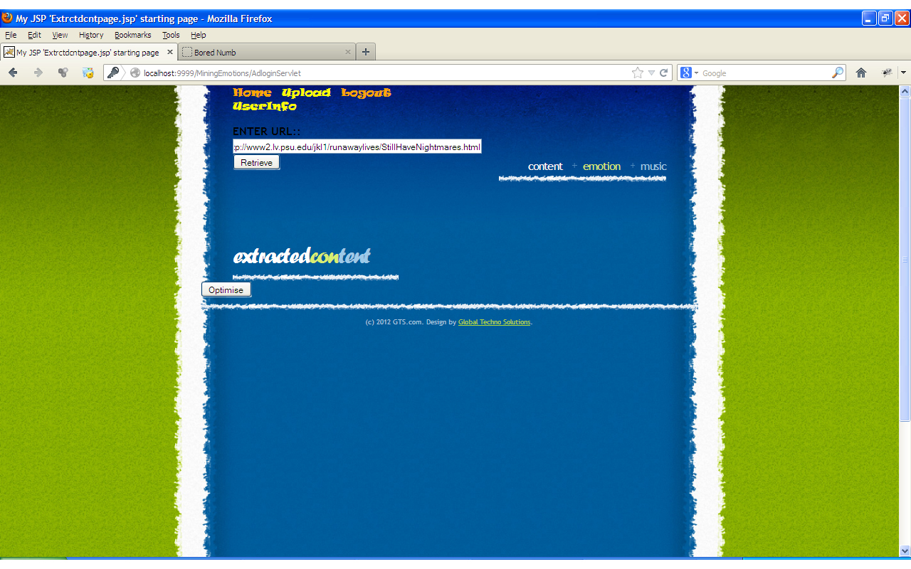
EXTRACTION PROCESSES
AFFECTIVE TEXT BASED EMOTION MINING IN SOCIAL MEDIA
13 of 23

Slide 15
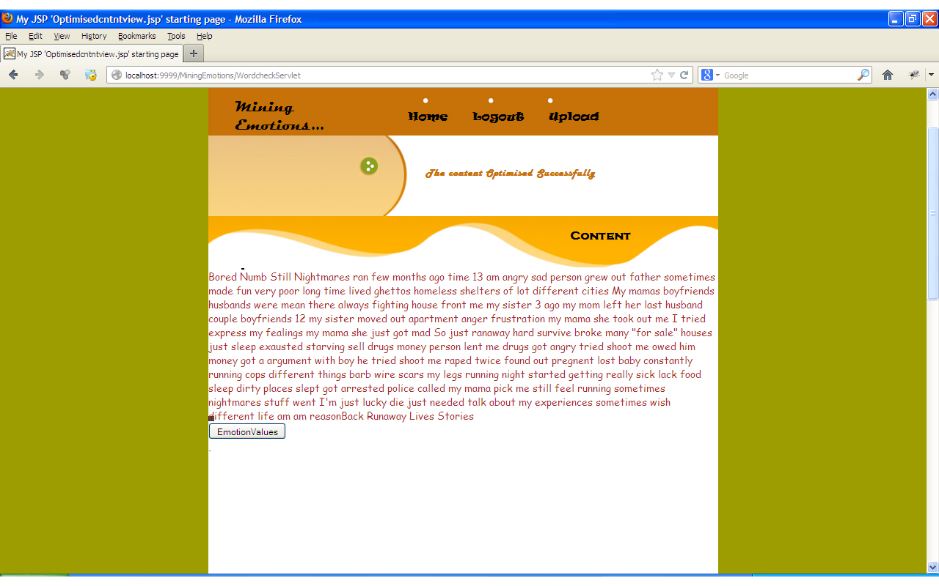
OPTIMIZATION PROCESS
AFFECTIVE TEXT BASED EMOTION MINING IN SOCIAL MEDIA
14 of 23

Slide 16
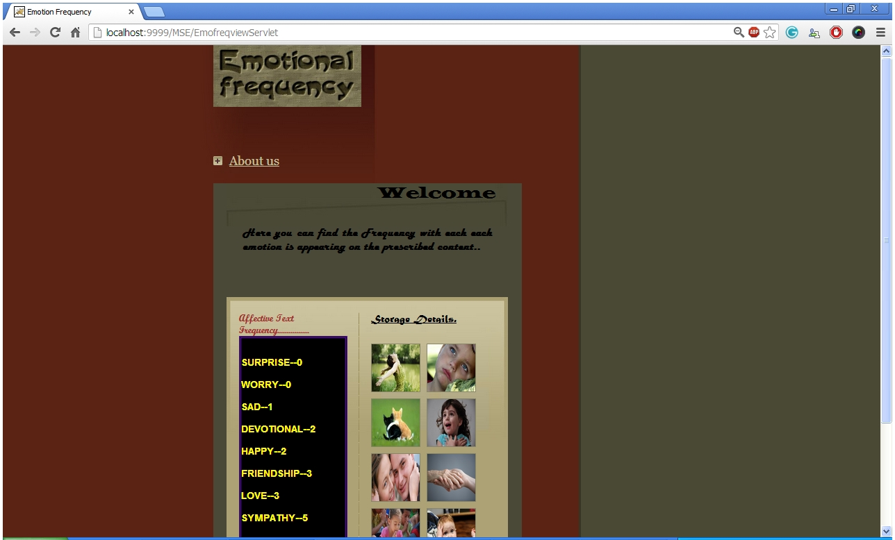
EMOTION PREDICTION
AFFECTIVE TEXT BASED EMOTION MINING IN SOCIAL MEDIA
15 of 23

Slide 17
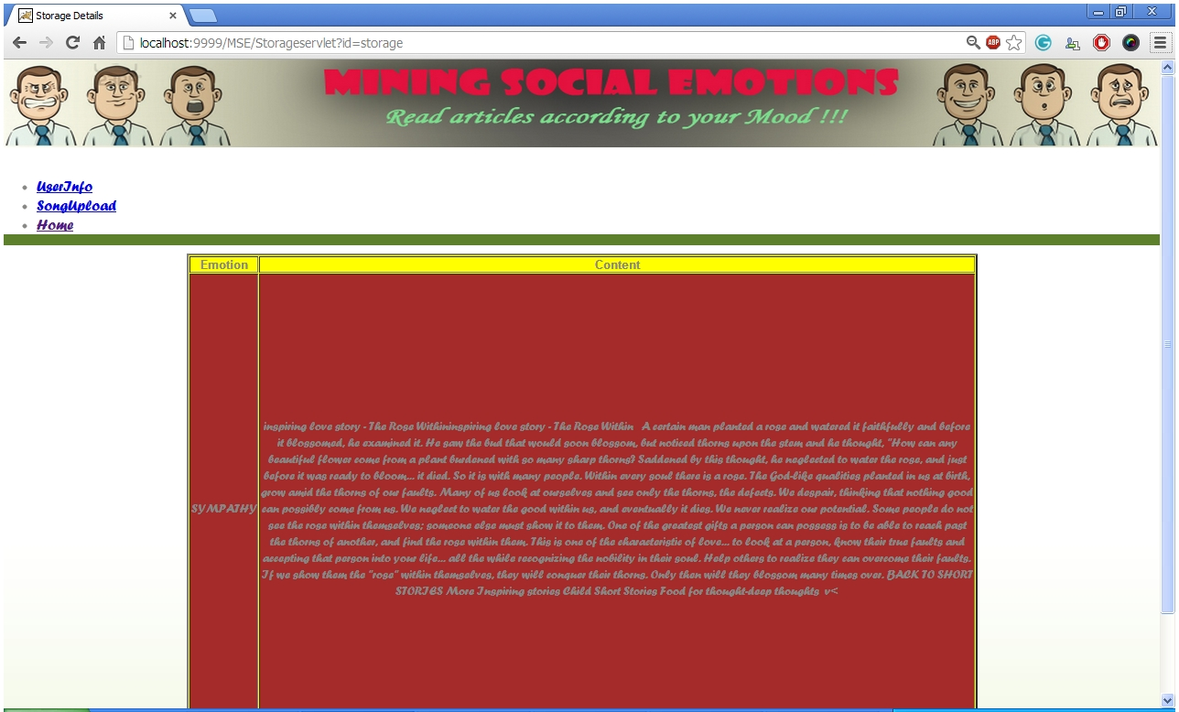
STORAGE DETAILS
AFFECTIVE TEXT BASED EMOTION MINING IN SOCIAL MEDIA
16 of 23

Slide 18
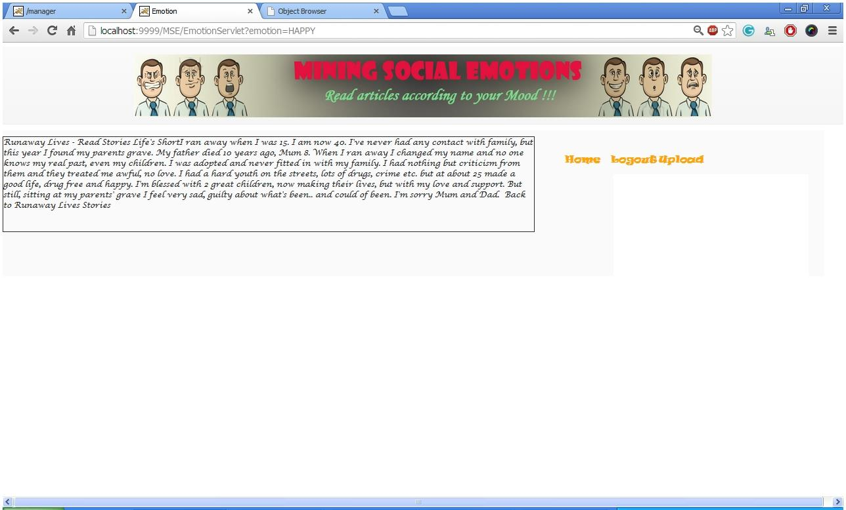
RETRIEVED CONTENT
AFFECTIVE TEXT BASED EMOTION MINING IN SOCIAL MEDIA
17 of 23

Slide 19
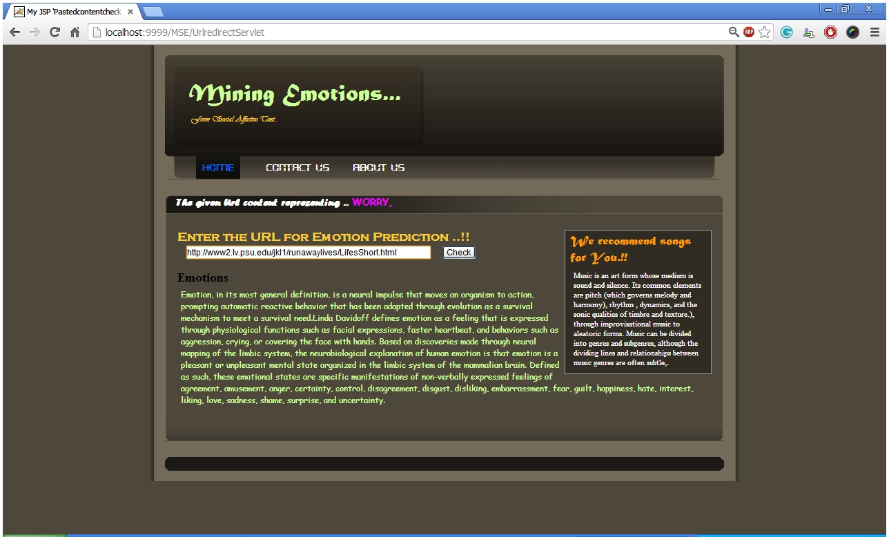
EMOTION PREDICTION USING URL
AFFECTIVE TEXT BASED EMOTION MINING IN SOCIAL MEDIA
18 of 23

Slide 20
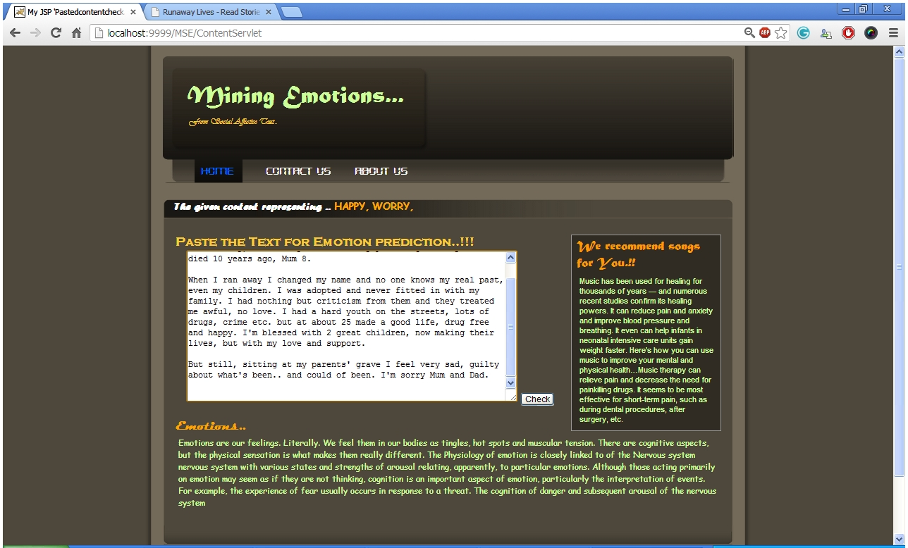
EMOTION PREDICTION BY CONTENT PASTING
AFFECTIVE TEXT BASED EMOTION MINING IN SOCIAL MEDIA
19 of 23

Slide 21
CONCLUSION
In this project we effectively identify meaningful latent topics for each emotion. Evaluation on emotion prediction further verifies the effectiveness of the proposed model and predicting emotions from online documents. It provides a new aspect for document categorization.
AFFECTIVE TEXT BASED EMOTION MINING IN SOCIAL MEDIA
20 of 23

Slide 22
FUTURE ENHANCEMENT
The user generated social emotions provide a new aspect for document categorization, and they cannot only help online users select related documents based on emotional preferences, but also benefit a number of other applications such as contextual music recommendation. Several studies have been carried out to automatically predict the most probable emotions for documents.
AFFECTIVE TEXT BASED EMOTION MINING IN SOCIAL MEDIA
21 of 23

Slide 23
REFERENCES
[1] “Mining Social Emotions from Affective Text” Shenghua Bao, Shengliang Xu, Li Zhang, Rong Yan, Zhong Su, Dingyi Han, and Yong Yu VOL. 24, NO. 9, SEP 2012
[2] “Semeval-2007 Task 14: Affective Text,” C. Strapparava and R. Mihalcea, Proc. Fourth Int’l Workshop Semantic Evaluations (SemEval ’07), pp. 70-74, 2007.
[3 “Emotion Classification Using Web Blog Corpora,” ] C. Yang, K.H.-Y. Lin, and H.-H. Chen Proc. IEEE/WIC/ACM Int’l Conf. Web Intelligence (WI ’07), pp. 275-278, 2007.
[4] “Emotions from Text: Machine Learning for Text-Based Emotion Prediction,” C.O. Alm, D. Roth, and R. Sproat, Proc. Joint Conf. Human Language Technology and Empirical Methods in Natural Language Processing (HLT/EMNLP ’05), pp. 579-586, 2005.
AFFECTIVE TEXT BASED EMOTION MINING IN SOCIAL MEDIA
22 of 23

Slide 24
REFERENCES
[5], “Learning to Identify Emotions in Text,” C. Strapparava and R. Mihalcea Proc. 23rd Ann. ACM Symp. Applied Computing (SAC ’08), pp. 1556-1560, 2008.
[6 “Sentiwordnet: A Pub-Licly Available Lexical Resource for Opinion Mining,” ] A. Esuli and F. Sebastiani, Proc. Fifth Int’l Conf. Language Resources and Evaluation (LREC ’06), 2006.
[7] “Wordnet-Affect: An Affective Extension of Wordnet,” C. Strapparava and A. Valitutti, Proc. Fourth Int’l Conf. Language Resources and Evaluation (LREC ’04), 2004.
[8] “Latent Dirichlet Allocation,” D.M. Blei, A.Y. Ng, and M.I. Jordan, J. Machine Learning Research, vol. 3, pp. 993-1022, 2003.
AFFECTIVE TEXT BASED EMOTION MINING IN SOCIAL MEDIA
23 of 23

Slide 25
THANK YOU!
AFFECTIVE TEXT BASED EMOTION MINING IN SOCIAL MEDIA

